Slide 1
Federal Political Financing in Canada 2004 - 2013
Satish Terala, Will de la Guardia, Tim Groves, Robert Palinic, Houtsin Diep

Slide 2
Contents
Contributions by Party from 2004 – 2013
Estate Breakdown by Party
Top Individual Donations 2013
Provincial Funding Balance
Appointee, Ambassador, Lobbyist, Donations by Party 2013

Slide 3
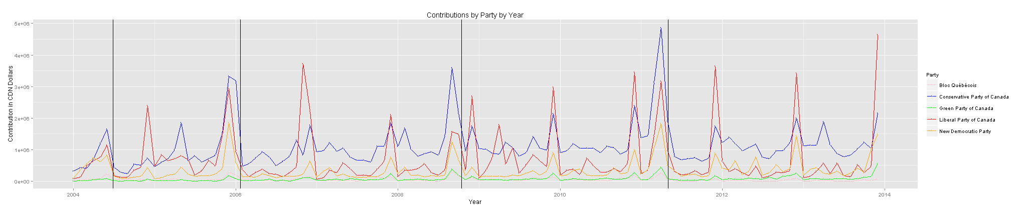

Slide 5
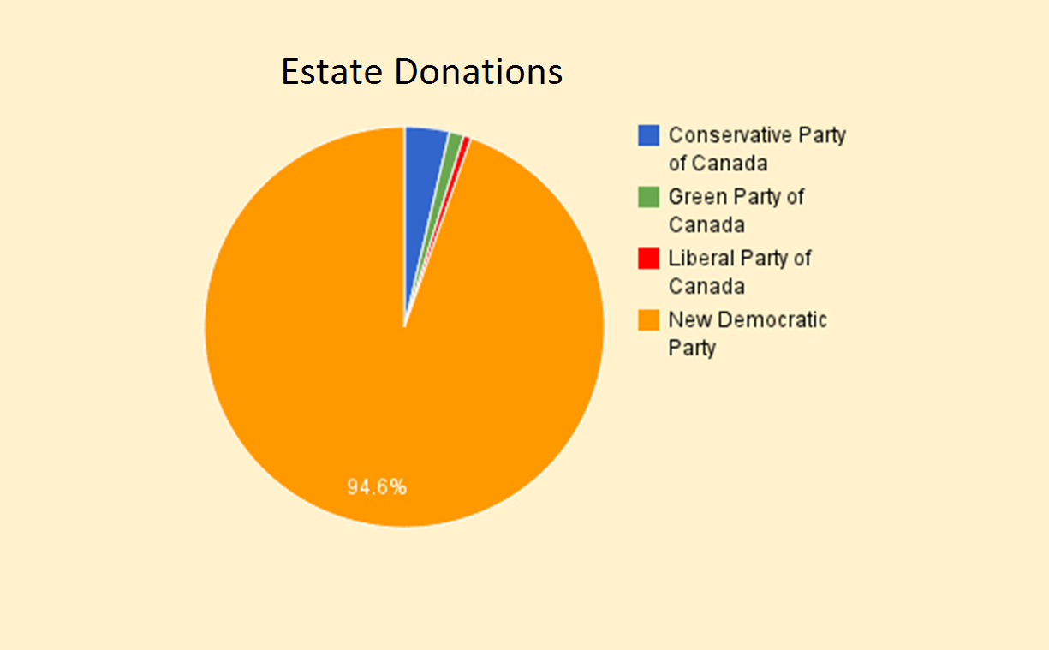
http://www.cbc.ca/news/politics/elections-bill-s-cap-on-estate-donations-may-hit-ndp-1.2523366

Slide 6
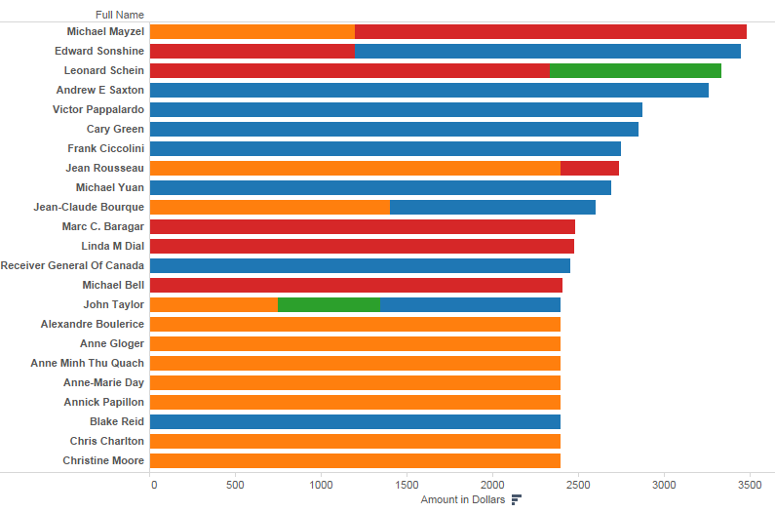
Top Individual Donations 2013

Slide 7
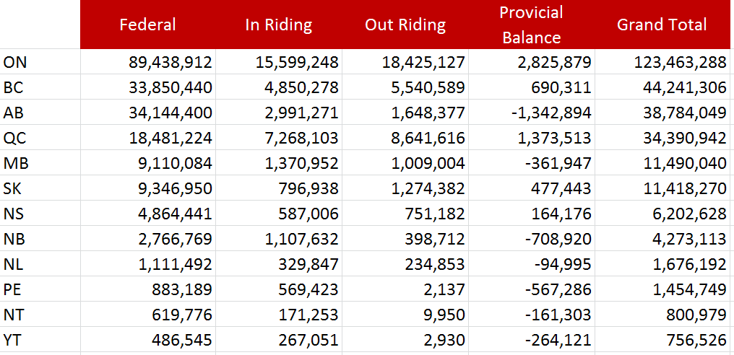
Provincial Funding Balance

